Slide 1
STRATEGIC PLANNING MEMBER SURVEY INSIGHTS
8 February 2023

Slide 2
How the Webinar Will Work…
This session will be recorded.
Due to the amount of content, we will not use chat today
Please use the QUESTION feature.
Headquarters staff will respond to questions online or panelists will respond verbally during the presentation breaks and at the end.

Slide 3
Agenda
Strategic Planning Update
Zonta International President Ute Scholz
Quantitative Survey Report
Nikki Golden, CAE, Association Laboratories
Next Steps
Zonta International Treasurer/Secretary Souella Cumming

Slide 4
A brief update on the strategic plan progress
https://www.zonta.org/strategicplan

Slide 5
The Objective
Develop a new strategic plan to meet the needs of Zontians
while opening new pathways
for other gender equality advocates
who care about our causes to engage with Zonta.

Slide 6
Information Gathering
In 2020, Zonta International leaders recognized a need to prepare for the future.
Convention approved review of Zonta International in 2020 and continued in 2022.
There was an evaluation of Zonta data, trends, assets and financial health.
A PESTLE analysis was completed.
Working groups reviewed internal operations and programs.
Member-based focus groups were led.
Two member surveys were conducted.
The Zonta International Board met at Headquarters in January.
SOME AREAS DISCUSSED
Gender-based issues facing women and girls
Evolution of technology and societal structures
Position of Zonta International

Slide 7
Information Analysis
Strategic planning is a process with two levels.
The first level is to define the focus and vision for the future.
The second level is to investigate, determine, and prioritize the strategies and tactics to take us to that future.
This presentation is intended to provide insights into what the Zonta community views as priorities and needs for the plan

Slide 8
Quantitative Survey Report
Nikki Golden, CAE, Association Laboratory
December 2022

Slide 9
Demographics
Who are Zontians: How long have they been members and where are they and how many have held leadership positions?
Notes:
On behalf of Zonta International, Association Laboratory sent an email for the survey to Zonta International’s database, which included members, former members and non-members (those who were on Zonta’s e-newsletter list or a USA Caucus subscriber).
Data collection occurred between Oct. 31, 2022, and Nov. 27, 2022.
Overall, 28,304 valid emails were sent, and a total of 3,847 responses were received for a response rate of 14%.
Members: 21,234 valid emails were sent, 3,564completed, 17% response rate
Former Members: 175 valid emails were sent,6 completed, 3% response rate (too small to analyze)
Non-members: 7070 valid emails were sent, 283 completed, 4% response rate
Non-member emails came from e-newsletter subscriber list and USA Caucus subscriber list
Three reminders were sent to those who had not yet responded, and Zonta International sent emails to leadership, publicized on social media channels and reached out to Governors and districts with low response rate.
Significance tests were performed at the 95% confidence level
Individuals could respond using a laptop/desktop computer, tablet or smartphone.33% of respondents completed the survey using a mobile device.
Respondents who completed the survey could enter for a drawing to win 5 Zonta water bottles. Association Laboratory needs to pull the list and send the names to Zonta International to fulfill

Slide 10
Who are Zontians?
Category | Respondents
Region | 29% North America 35% Europe 18% Australia/New Zealand .07% Asia .01% Africa
Age | 3% 35 and Under 10% 36-50 38% 51-65 49% 66+
Years as a Zontian | 31% 5 years or less 29% 6 years to 15 years 22% 16-25 years 18% 26+
60% of Zontians have been members for less than 15 years.

Slide 11
93% of respondents are Zonta members.
Of the non-members who responded:
2% were former members
80% were e-Newsletter subscribers
20% were USA Caucus Subscribers
Data came from Zonta International’s database and lists.
n=3847
Member Status

Slide 12
73% of respondents have held elected positions, with 49% currently a club president or Board member
Which best describes your volunteer relationship with Zonta?* Choose all that apply. n=2546
Have you held an elected position within your club, district or Zonta International in the last five years? n=3540
* Those who responded they held an elected position within the last five years received a follow-up question.

Slide 13
Environmental Scan
What are the issues that will be impacting women and girls in the next three years, and what should Zonta prioritize to work on in its strategic plan?

Slide 14
Fear of gender-based violence (38%), lack of personal financial freedom (29%) and fear of impact of climate change (27%) are the top 3 issues impacting women locally, in the next 3 years
Select the top 3 issues facing women and girls over the next 3 years in your local area.
n=3751

Slide 15
Supporting educational opportunities (63%), protecting the individual or human rights of women and girls (54%) and improving job or economic opportunities should be the top 3 priorities for Zonta International over the next 3 years
What are your top 3 priorities for Zonta International over the next 3 years? Select up to 3.
n=3753

Slide 16
Questions?
Notes:
Was there anything you’re surprised by in there or anything you’re surprised WASN’T mentioned in there?

Slide 17
Zonta International/Zonta club
The following were a series of questions designed to understand how respondents viewed both Zonta International in relation to its club, to allow Zonta International to focus its strategic plan where the relationship might need the most support and understand where people were choosing where to put their time and energy to participate.

Slide 18
Working on local service projects is the most important reason for 52% of respondents to participate in their local club or e-club.
What are the 3 most important reasons for participating in your local Zonta club or e-club? Select up to 3.
n=3451

Slide 19
Learning about the global issues impacting women or girls (50%) and supporting efforts by the UN to advance women and girls are the top areas of participating in Zonta International
n=3465
What are the 3 most important reasons for participating at the worldwide level of Zonta International? Select up to 3.

Slide 20
Of those who don’t participate in their local club or e-club, their primary reason is unclear as a plurality indicate none of the above (41%). The next top response for not participating is due to a club not being in their area (15%)
This question was only asked of those who answered no in Question 5 (Do you participate in your local club or e-club) and to non-members.
Those who were aged 35-50 were more likely to respond:
My family responsibilities limit my time: 29%
There is no Zonta club in my area: 24%
I don’t know how to get involved: 24%
Those over age 51 were most likely to say “none of the above:”
51-65: 54%
Over 66: 46%
n=298
Why do you not participate with Zonta?

Slide 21
78% of Zontians think Zonta’s role in advocacy is the way to advance women or girls. Service is the second most important role for those 35 and Under (64%) and those in Africa (75%).
By age or region, Advocacy is the top way for Zonta International to advance women and girls. For Zontians under 35, service comes in No. 2 at 64%, compared with 56% for those 36-65 and 58% for those 66+.
By region, Service comes in No. 2 for those in Africa (75%), compared with North America (62%), Europe (50%), Australia/New Zealand (59%) and Asia (67%).
n=3528
When you think what Zonta International might do to advance women or girls, what are the 3 most important areas? Select up to 3.

Slide 22
Although Zonta International plays a slightly more important role in the success of Zonta’s mission, respondents are more satisfied with their clubs.
Respondents were asked to rate the response on a level of satisfaction. These responses reflect Very Satisfied + Somewhat Important
Respondents were asked to rate the response on a level of importance. These responses reflect Extremely Important + Moderately Important
n=3287-3479

Slide 23
Although people feel welcomed to contribute positively to their Zonta club (93%), they have less confidence that their Zonta club will be successful in the next five years.

Slide 24
Zontians who are unsure or said no to feeling welcomed to positively contribute provided these reasons:
Women are not supportive of each other in some clubs (bullying, inclusivity, small group make decisions for all)
Older members not open to new ways of doing things or new viewpoints
Club members interested in organizing activities that are outside of Zonta International’s mission
Small membership
Lacks direction, strategy, focus
Too rigid (too many protocols, complex structure, etc)
New members unsure of how to become more involved (or feel their ideas not welcome)
Individual (“supporting”) members feel shunned because they’re not part of a club
Same people do all the work

Slide 25
Respondents feel less welcome to positively contribute to Zonta International (71%) compared to Zonta club (93% in former slide). 67% feel Zonta International is set up to be successful in the next five years

Slide 26
The reasons Zontians don’t know or don’t think they are welcome to contribute positively to Zonta International
Unsure of process/process too complex
Lack of support from district level
Time is limited and it seems time-consuming
Too expensive
Don’t feel connected because everything is in English
Communication issues (both don’t know what’s happening and too many communications)
Don’t feel there is connection with club to Zonta International
Feel there is resistance to change
Contribute already through fees and fund-raising
Local region gets little in return
New member/haven’t explored getting more involved
ZI doesn’t collaborate well with districts

Slide 27
72% of respondents find the current club model very desirable/desirable, followed by 52% that find a model that allows participants to act as advocates to be very desirable/desirable
n=3753
Zonta International is exploring alternate options of how people can participate with Zonta in the future. As you consider the variety of ways people might want to participate in the mission of empowering women and girls, how do you view the following engagement models?

Slide 28
Questions?
Notes:
Was there anything you’re surprised by in there or anything you’re surprised WASN’T mentioned in there?

Slide 29
What do club leaders think?
Those who responded that they were current club presidents or Board members saw a series of questions about Zonta International, its awards program, its fund-raising and its advocacy efforts.

Slide 30
The majority of Zonta leaders think Zonta International is a reliable communicator (84%) that acts consistently with its public statements (80%)
These questions were displayed individually, and respondents were asked on a 5-point scale whether they agreed with the statement. These percentages represent strongly agree + agree.
n=1243-1218
To what extent do you agree or disagree with each of the following statements regarding Zonta International? Zonta International is …

Slide 31
Engineering, public affairs, STEM and business are still important areas to focus Zonta International’s scholarship dollars (85%), according to club leaders
n=1239
To what extent do you agree or disagree with each of the following statements regarding Zonta International’s education awards (Amelia Earhart Fellowship, Women in Business Scholarship, Women in STEM Scholarship, Young Women in Public Affairs Award)?

Slide 32
What are the areas Zonta International should target with its scholarship dollars?
Unnecessary to give scholarships Better allocate to advocacy or service projects benefiting more rather than benefit a few scholars I do not think that these Scholarships are very necessary Less structure to how money is spent Any area of education that helps women and girls getting a scholarship to help them reach a higher education
Education
Enabling educational participation for girls in countries where this is a challenge I think there could be scholarships also in "soft" areas like social studies, pedagogy, psychology - not only the male-dominated fields of education are to give recognition in gender issues Media/public policy/health care
Degrees in media to promote advocacy, medical
Entrepreneurial efforts, big & small
Health policy, medicine.
Many young women are employed in the health sector so targeted scholarships in this area would help many women achieve their goals
Medical field
Medicine, entrepreneurship
political education and empowerment of women; delivery of health care policy and education; legal education and policy; advocacy and community engagement.
Developing countries primary education in developing countries - scholarships in science and technology
The poorest girls Women and girls in economic disadvantage. Rewarding excellence out of that context does not speak to me al all.

Slide 33
There isn’t a clear reason about the challenges to participate as an advocate, as a plurality indicate none of the above (44%). The next top reason was that they don’t know how to participate in Zonta International’s advocacy efforts
Those over 35 were most likely to say “none of the above”:
Those under 35 were most likely to say I don’t know how to participate in Zonta International’s advocacy efforts or I do not know who to talk to in order to have an impact.
n=3475
What are the 3 biggest challenges to your participation as an advocate on behalf of Zonta International? Select up to 3.

Slide 34
80% of club leaders know what projects Zonta International is involved in this biennium, and 76% believe the involvement in service projects is valued by Zonta club members
n=1221-1229
To what extent do you agree or disagree with each of the following statements regarding Zonta International’s service projects?

Slide 35
83% of club leaders think Zonta Foundation for Women should seek funding from external sources
These questions were displayed individually, and respondents were asked on a 5-point scale whether they agreed with the statement. These percentages represent strongly agree + agree.
To what extent do you agree or disagree with each of the following statements regarding fund-raising for the Zonta Foundation for Women?
n=1207-1217

Slide 36
The majority of funds raised by clubs is from internal sources, such as members’ donations. 30% of clubs are sending at least 21-30% of their donations to Zonta International
What percentage of your club’s fund-raising efforts are provided from each of the following?
n=1241
What percentage of your club’s fund-raising is sent to Zonta International?
n=1164

Slide 37
Where We Stand Today
Again, the strategic planning is a process with two levels.
The first level is to define the focus and vision for the future.
The second level is to investigate, determine, and prioritize the strategies and tactics to take us to that future.
We are pleased to say that after months of work, the first level work is completed, and we are on to the second level work.

Slide 38
What’s Next?
February
March
April
May
June
July
August
September
October
November
The Board meetings to finalize strategic plan.
Prepare the strategic plan for publication.
Informational presentations at the interdistrict meetings April to June 2023.
Member webinars on final strategic plan July – September 2023.
Zonta International Board representatives deliver presentations at district conferences.
Potential Zonta International Bylaws possible amendments investigated
June – November 2023.

Slide 39
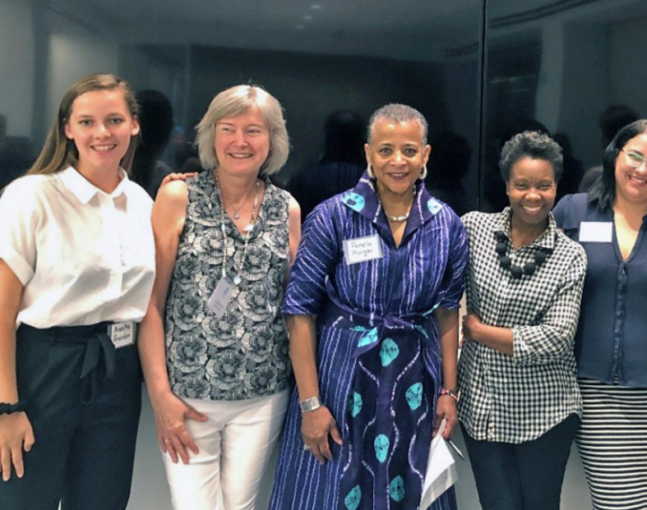
At the Core, Zonta Will Not Change
Zonta will remain a place where globally minded individuals connect, collaborate and demand change to build a better world for women and girls.
But we must remain relevant for the future and some change is necessary to be agile and impactful. Without change, we risk that Zonta’s light may dim…

Slide 40
Let’s move to the future together!

Slide 41
Questions?
Notes:
Was there anything you’re surprised by in there or anything you’re surprised WASN’T mentioned in there?

Slide 42
Appendix
About Association Laboratory

Slide 43
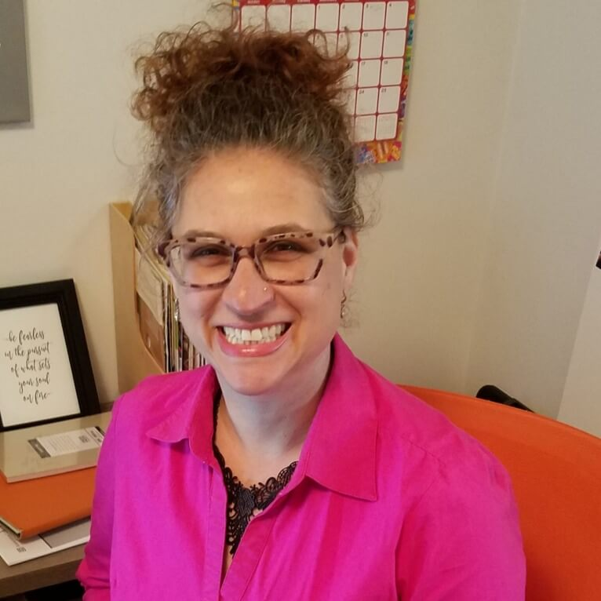
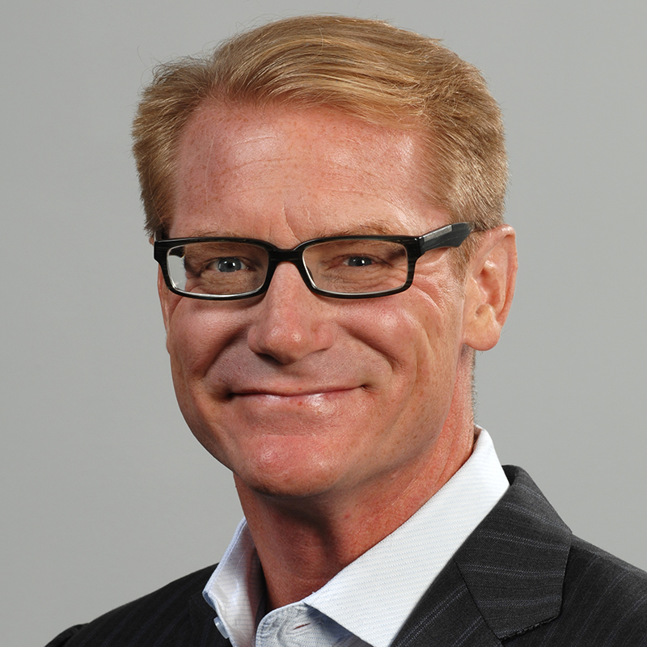
Association Laboratory Contributors
The following staff contributed to this Report
Nikki Golden, CAE
Strategist
Strategic Lead
Dean West, FASAE
President
Strategic Contributor

Slide 44
Association Laboratory’s Strategic Focus
Association Laboratory is an award-winning company serving a global client base of trade and professional associations since 1999. Three key areas of support include:
1
2
3
Sector Research & Insights
Education & Competency Development
Research & Strategy Consulting Services
Helping identify and implement successful business strategy. Specific areas include:
Producing and disseminating association sector research to hundreds of association leaders.
Producing strategic educational content helping association leaders develop the competencies necessary for success.

